Slide 1
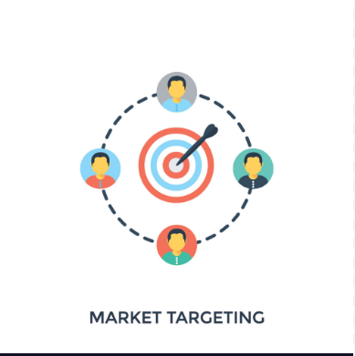

Slide 2
Market targeting
Also known as target marketing or target audience selection.

Slide 3
Market targeting
A target market is a specific group of people with shared characteristics that a business markets its products or services to.
Companies use target markets to thoroughly understand their potential customers and craft marketing strategies that help them meet their business and marketing objectives.

Slide 4
Target market examples
Fashionable clothing for pets targeting pet owners with disposable income aged 25 to 45
A high-end, direct-to-door meal kit company that targets busy professionals with disposable income ages 30 to 45

Slide 5
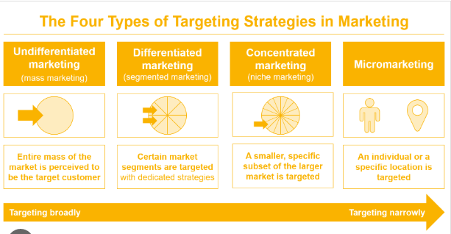
Market targeting strategies

Slide 6
1. Undifferentiated Targeting (Mass Marketing)
Strategy: Target the entire market with a standardized product and marketing mix.
Use Case: Products with universal appeal, such as basic commodities or certain household items.

Slide 7


Slide 8
2. Differentiated Targeting (Segmented Marketing)
Strategy: Target multiple market segments with different product variations and marketing approaches.
Use Case: Companies with diverse product lines or those catering to distinct customer groups with specific needs and preferences.

Slide 9
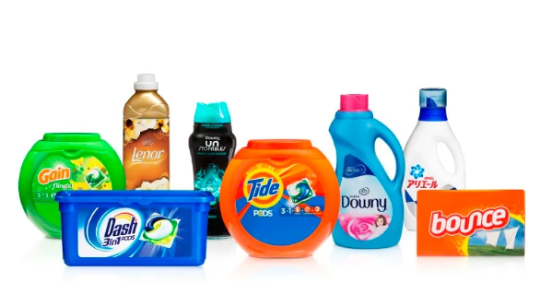

Slide 10
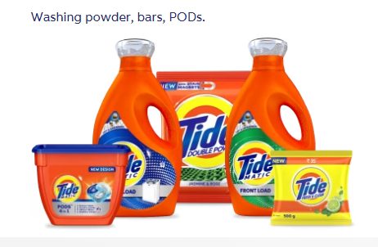
Versions of TIDE(INDIA)

Slide 11
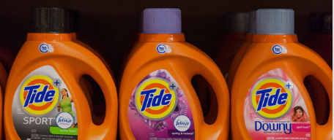

Across Globe

Slide 12
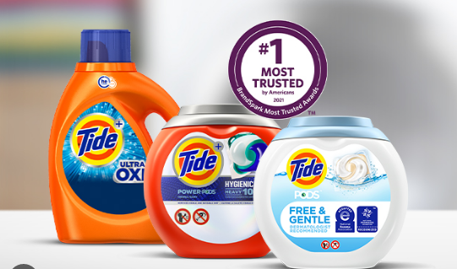

Slide 13
3. Concentrated Targeting (Niche Marketing)
Strategy: Concentrate efforts on a single, specific market segment.
Use Case: Businesses with limited resources or unique products that appeal to a specific group, aiming to dominate a niche market.

Slide 14

Rolex
A leading watch manufacturer, Rolex, creates various promotional campaigns to attract its target market segment.

Slide 15
4. Micromarketing
Strategy: Tailor products and marketing strategies to meet the individual needs of customers or very small segments.
Use Case: Personalized services, such as custom-made products, or local businesses catering to specific neighborhood preferences.

Slide 16
Micromarketing is an approach to advertising that tends to target a specific group of people in a niche market. With micromarketing, products or services are marketed directly to a targeted group of customers.

Slide 17

Practical Example

Slide 18
The company chose youth participating in extreme sports as their target group and built a successful marketing strategy around it.
The energy drink manufacturer started sponsoring extreme sports events, such as cliff diving in Hawaii and skateboarding in San Francisco.
It created excitement among the youth, who were attracted to the energy drink

Slide 19
Businesses often use a combination of these strategies based on their products, resources, and the characteristics of their target market. The choice of strategy depends on factors like the company's goals, competitive landscape, and the diversity of customer needs within the market.

